Slide 1
GT Group
GT Robot
GT Payment
GT Insurance
GT Dollar
GT Mobile
GT Premier Club
GT Smart City

Slide 2
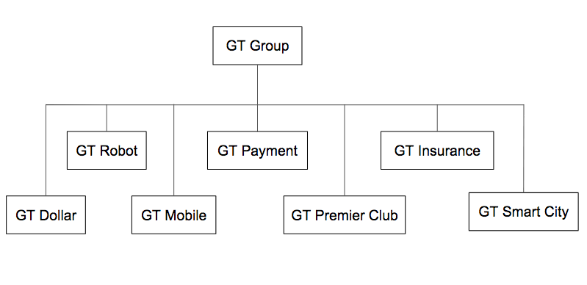

Slide 3
GT Wonder Boy (Robot)
GT Wonder Boy (Application)
DialogFlow
CMS Website
GT Wonder Boy (Robot)
GT Wonder Boy (Application)
DialogFlow
CMS Website

Slide 4
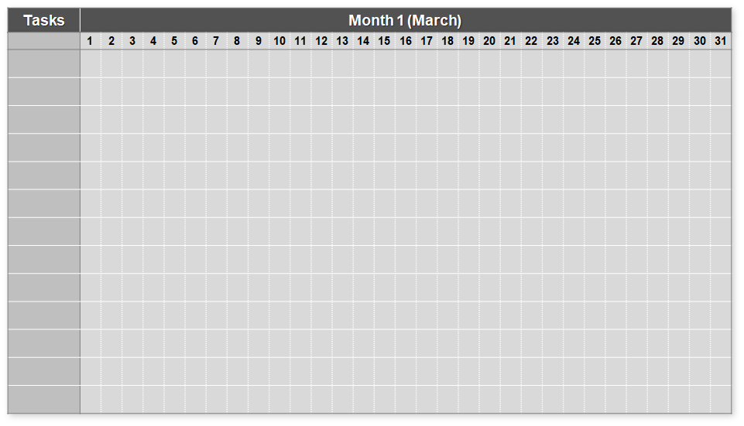
Sat/Sun
Sat/Sun
Sat/Sun
Sat/Sun
Intents Webpages
Create Intents
Edit Intents
Delete Intents
Complete Intents Pages
User Acc Webpages
Static
Webpages
Main Menu
Webpage
Complete Account Pages
Staff Acc Webpages
Creating Users
Managing Users

Slide 5

Sat/Sun
Sat/Sun
Sat/Sun
Sat/Sun
Staff Acc Webpages
Creating Users
Managing Users
Complete Staff Pages
Integrating External Addons
MongoDB Compass
DialogFlow API
JavaScript
AJAX
Complete
External Addons
Website Testing
Trial Testing
Debugging
Restructuring Codes
Complete Testing

Slide 6
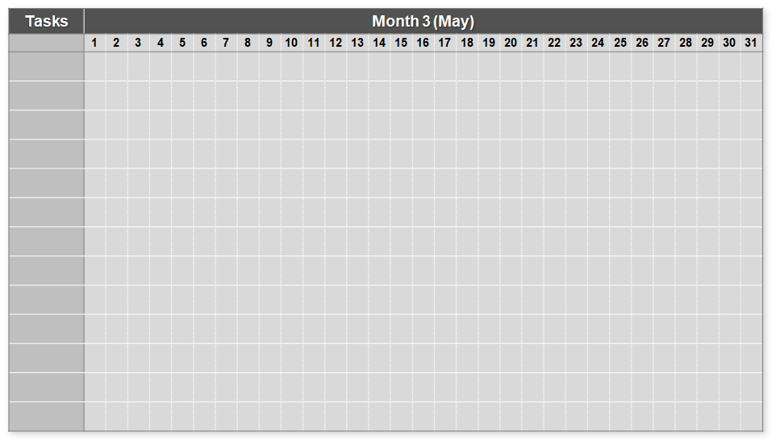
Sat/Sun
Sat/Sun
Sat/Sun
New User Requirement
Restructuring Intents
Testing New Codes
Debugging
Start of new project
UI Proposal
Designing HTML UI
End Of Internship

Slide 7
Legend
Task
Subtask
Milestone
End Of Internship

Slide 8




Slide 9
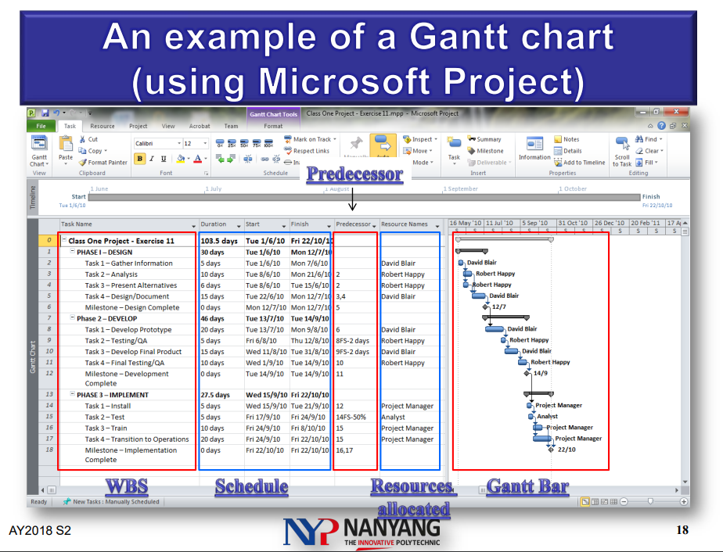

Slide 10
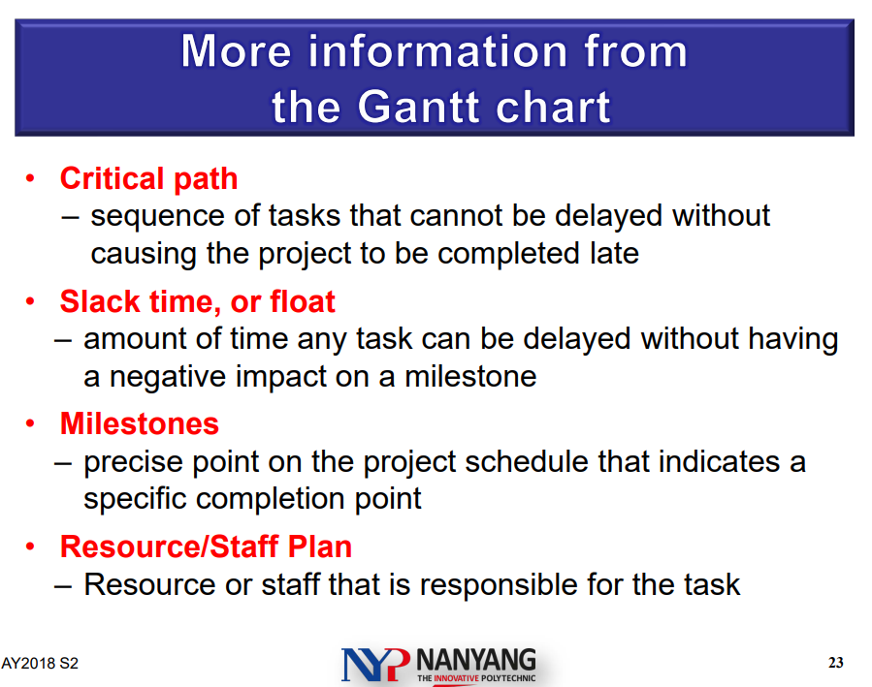

Slide 11
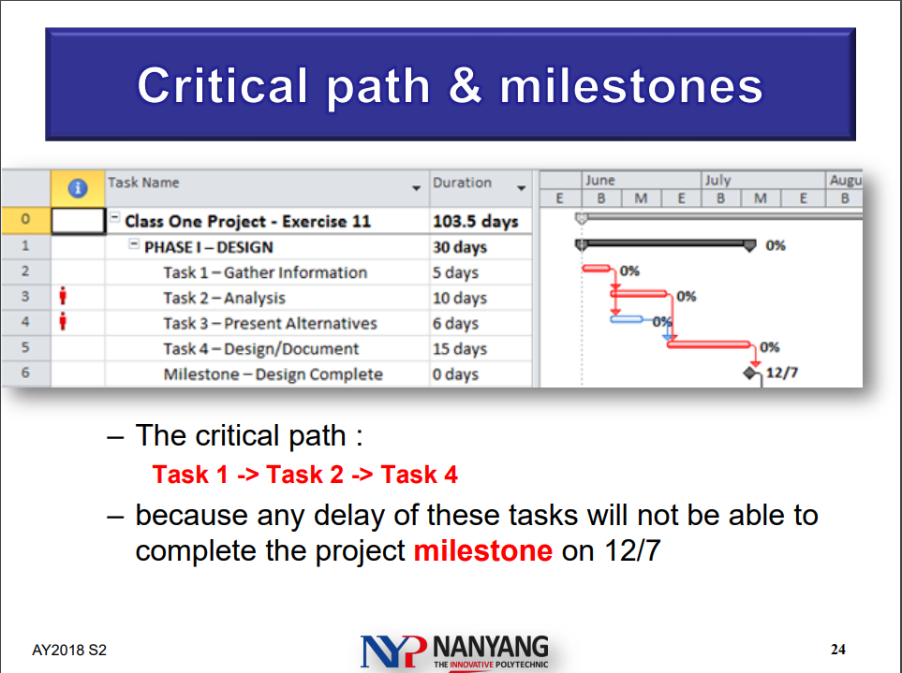

Slide 12
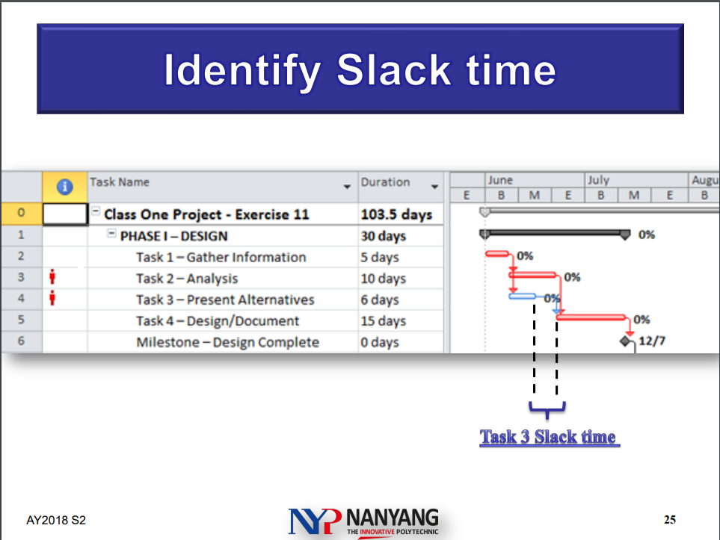

Slide 13
https://www.projectmanager.com/gantt-chart

